Slide 1

ENGINEERING
COLLEGE
UNI-GUIDE
Presented By :
Group 55
1.Ananya Shivanand Madhyastha-01JST21CS016
2.Shreya-01JST21CS139
3.Priya R Patil-01JCE21CS076
4.Sachin D-01JST21CS408
Guided By:
Prof. Mahesh K S
CS&E
JSSSTU,Mysuru.

Slide 2

CONTENT
Introduction
Literary Review
Design
Implementation
Test cases and Results
Future Enhancements
References

Slide 3



INTRODUCTION
Colleges play a pivotal role in students' lives, offering a platform for academic growth, personal development, and career preparation.
With around 600 engineering colleges in Karnataka, each offering a variety of courses, finding the right one can be challenging and time-consuming.
To simplify this process, we are creating a website that will serve as a one-stop destination for comprehensive information on all engineering institutions in Karnataka.
Our platform will feature detailed college profiles, course offerings, admission criteria, reviews, and more, making it easier for students to make informed decisions.

Slide 4
LITERATURE REVIEW
In Manual system ,users have to search each and every college individually for the admission process by physically gathering information, to obtain the desired information or by visiting college websites .
[1] provides information about techniques and tools to build an effective information retrieval system for college search which can help students save time and effort in their college search.
There are existing websites like College18.com, Collegedunia.com etc. which presents the information about various colleges present all over India but here issue is no one has provided exclusively for the colleges present in Karnataka.

Slide 5
DESIGN AND IMPLEMENTATION

Slide 6
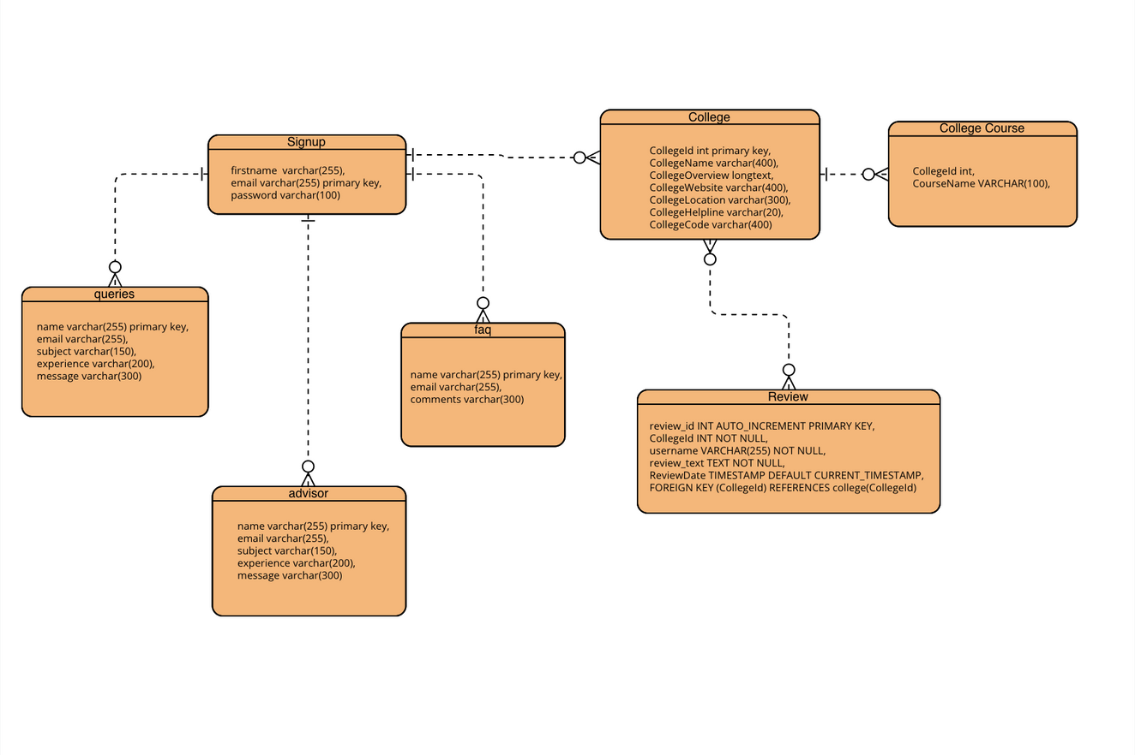

Slide 7
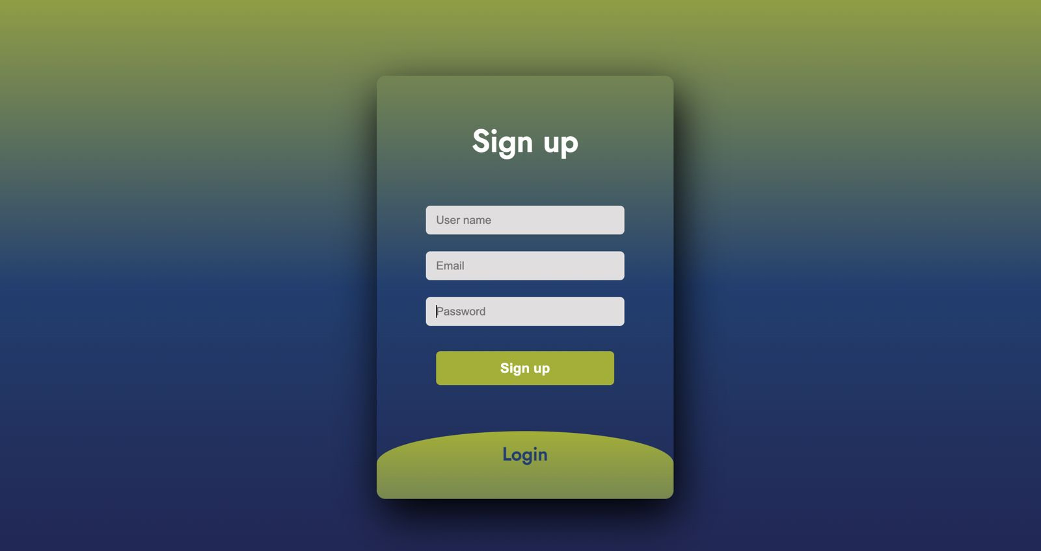
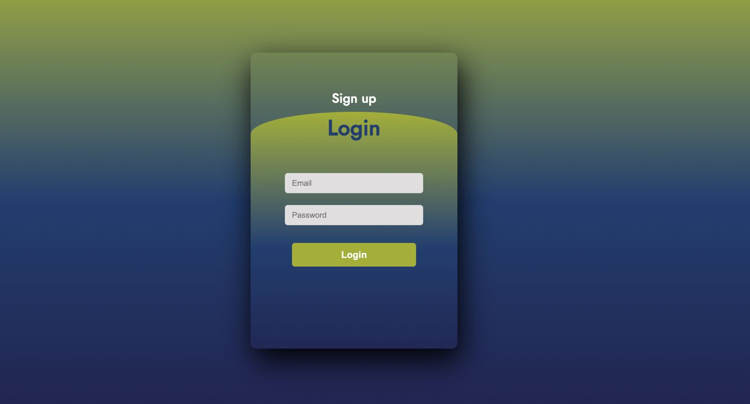
Fig 1: Sign Up page
Fig 2: Login page

Slide 8
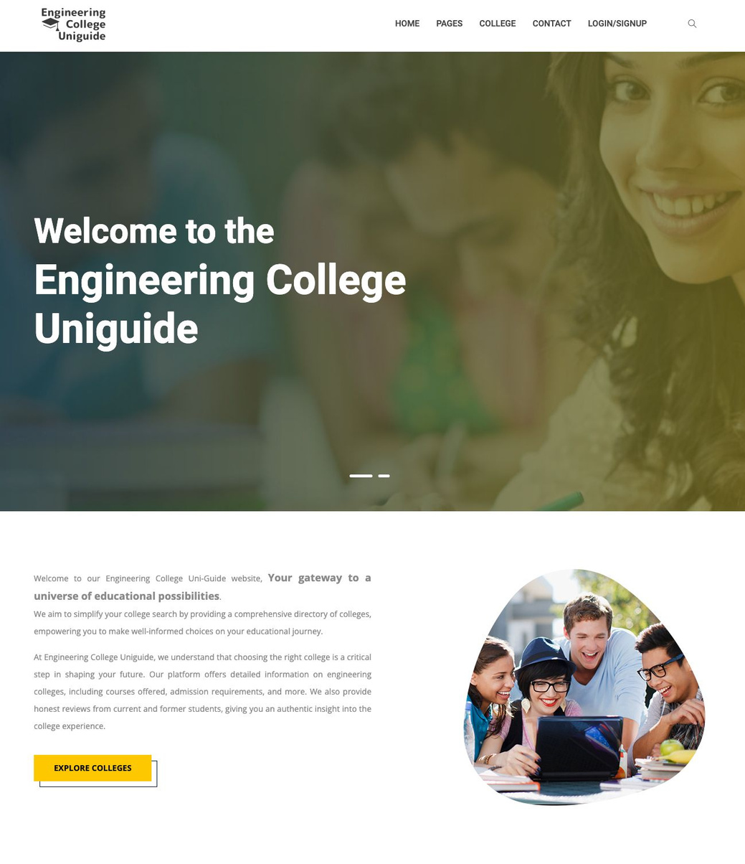
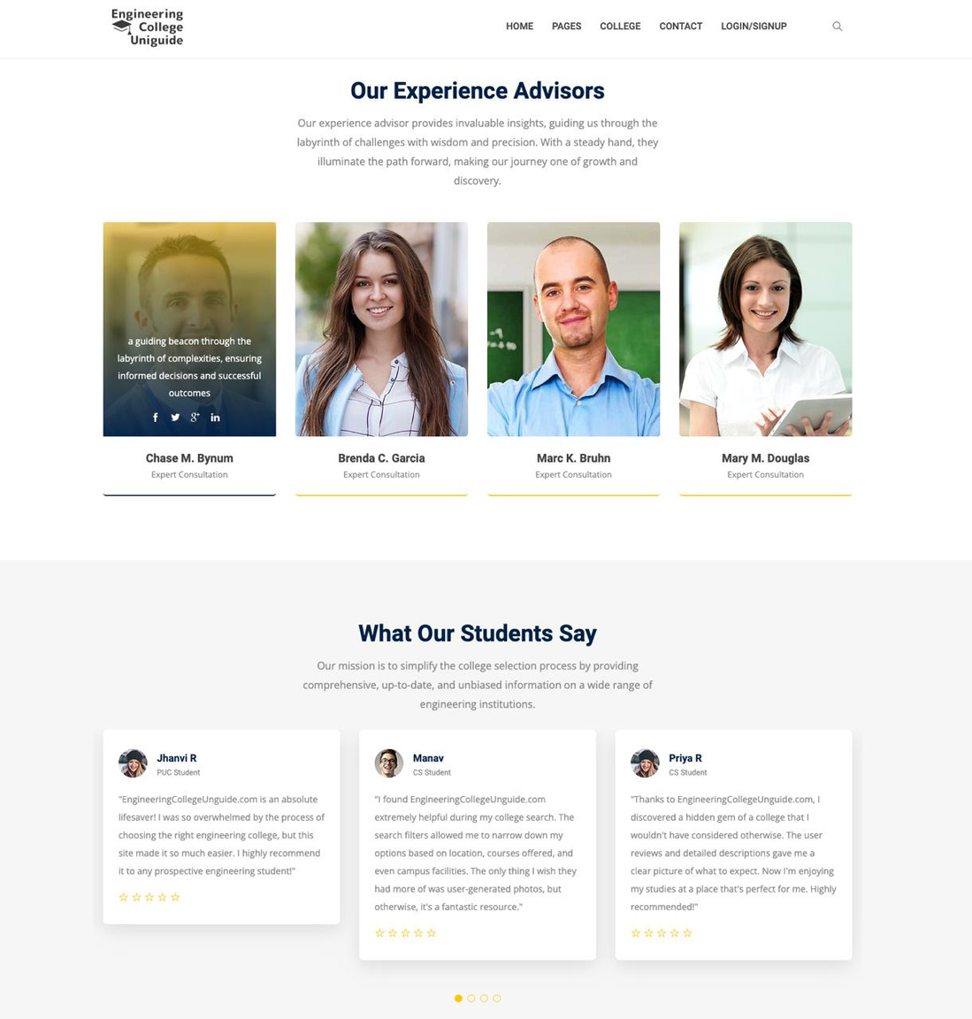
Fig 3,4 : Home page

Slide 9

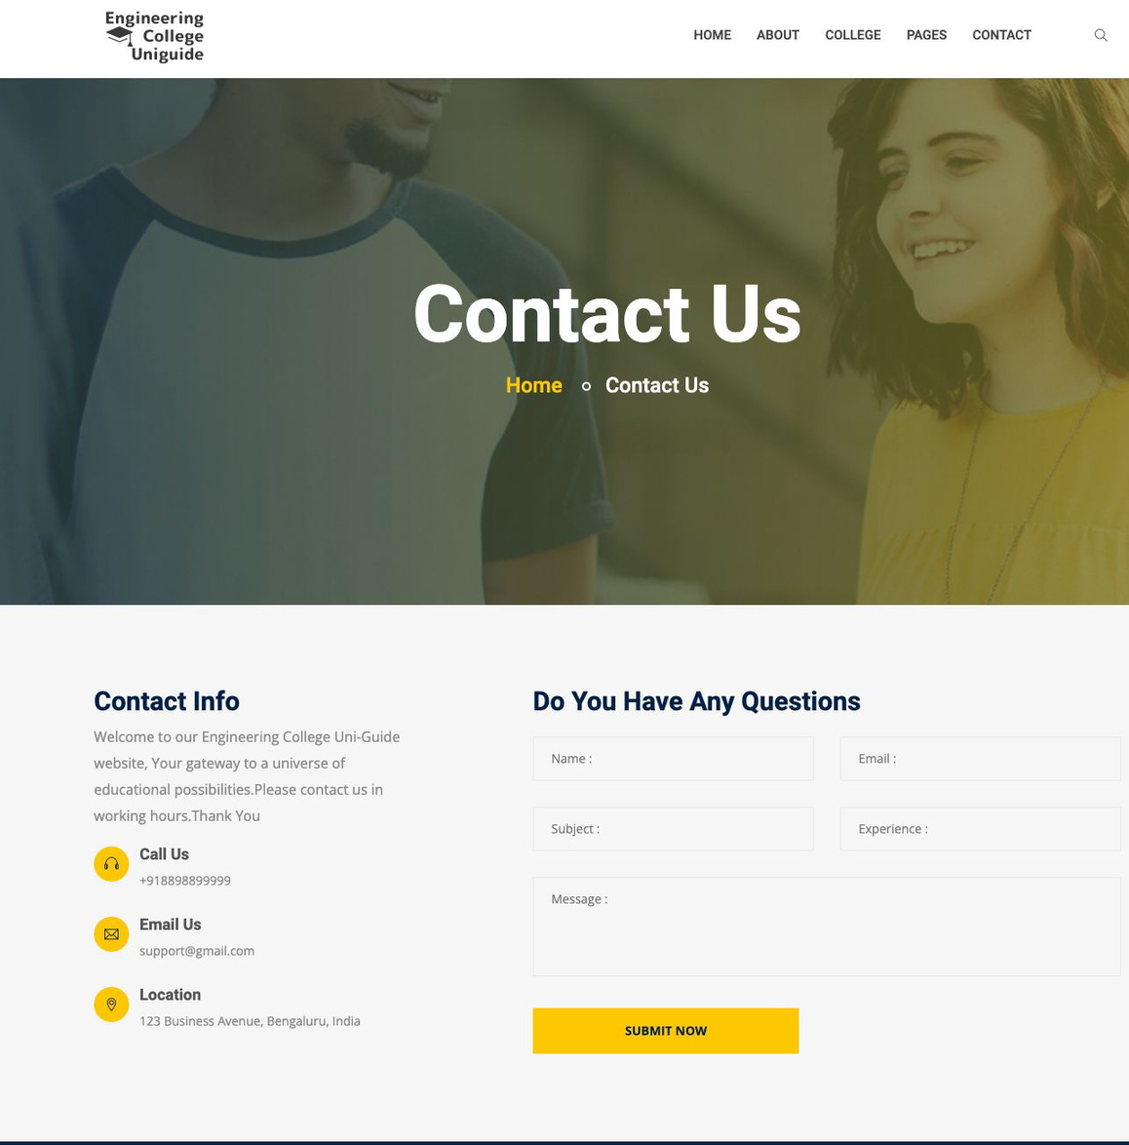
Fig 5: About Us page
Fig 6: Contact Us page

Slide 10
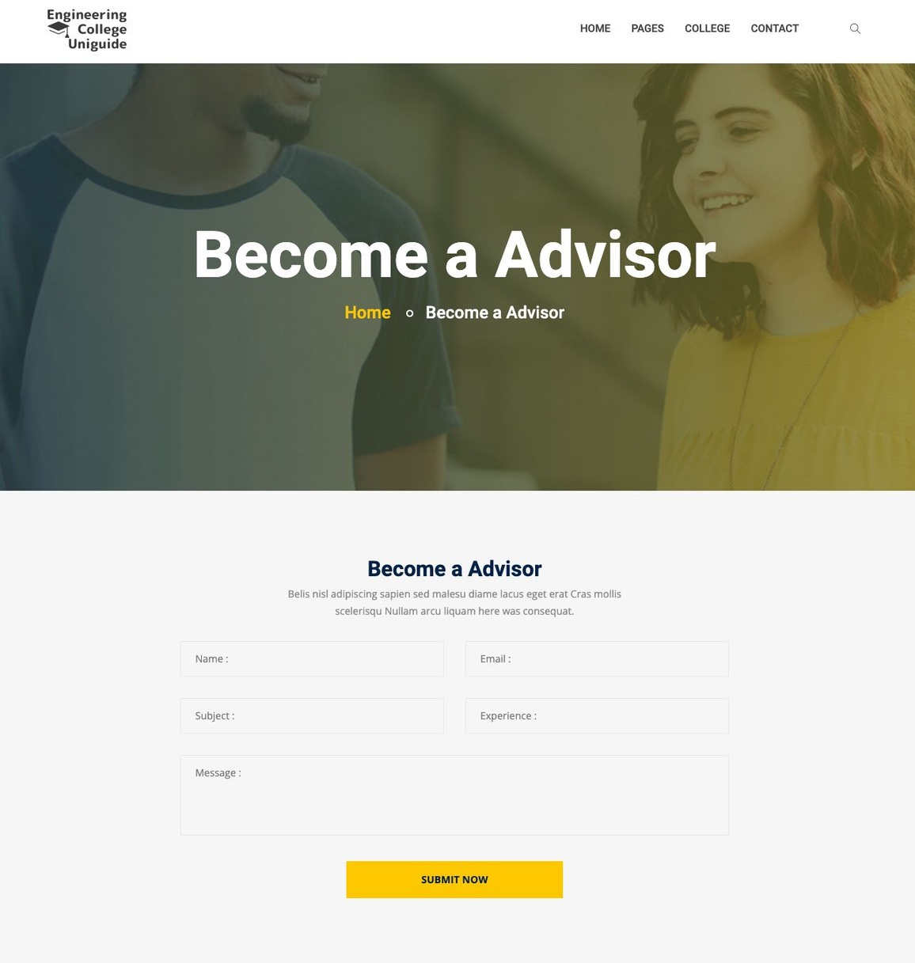
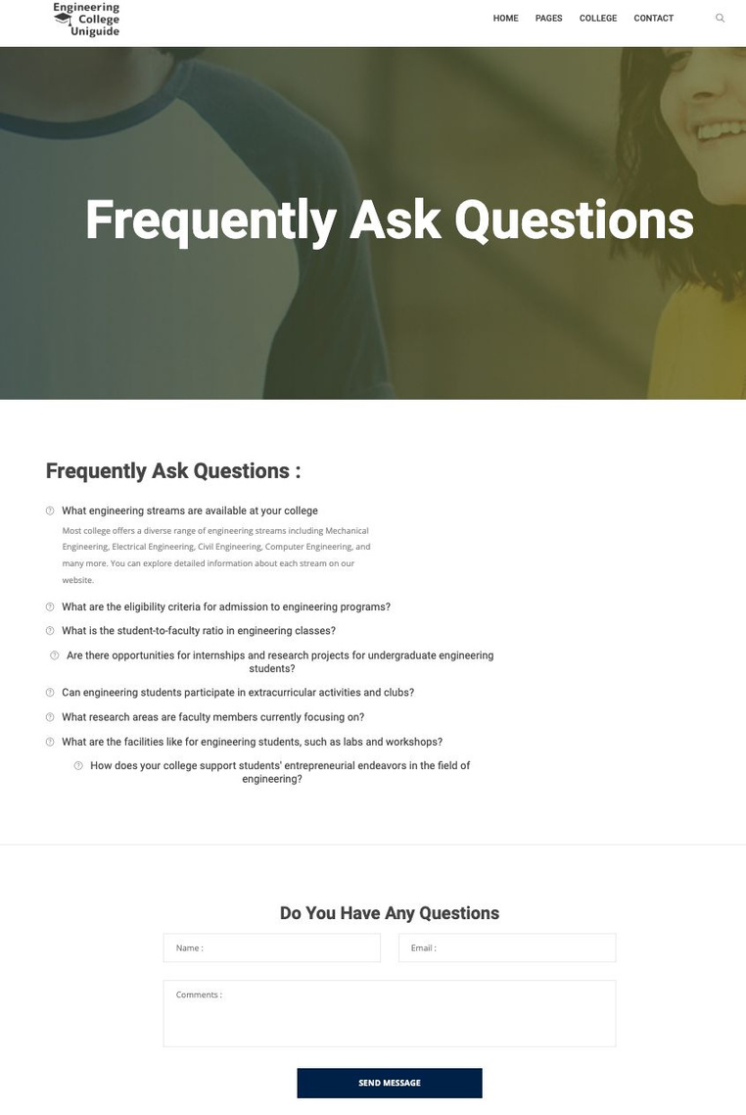
Fig 7: Become a Advisor
Fig 8: FAQ page

Slide 11
RESULTS AND TEST CASE

Slide 12
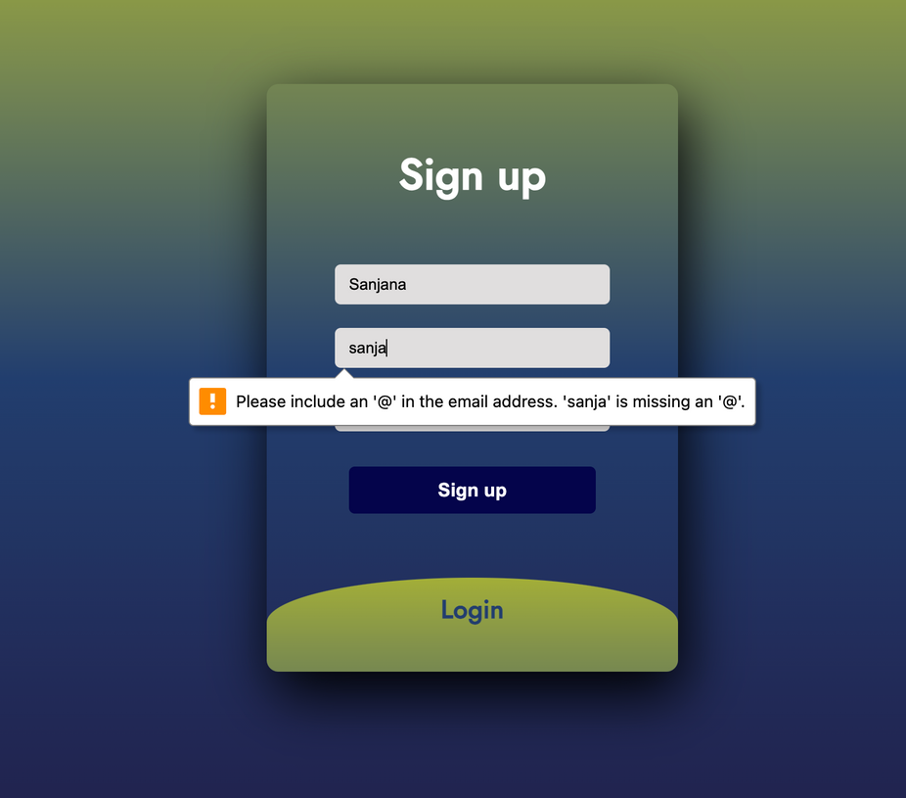
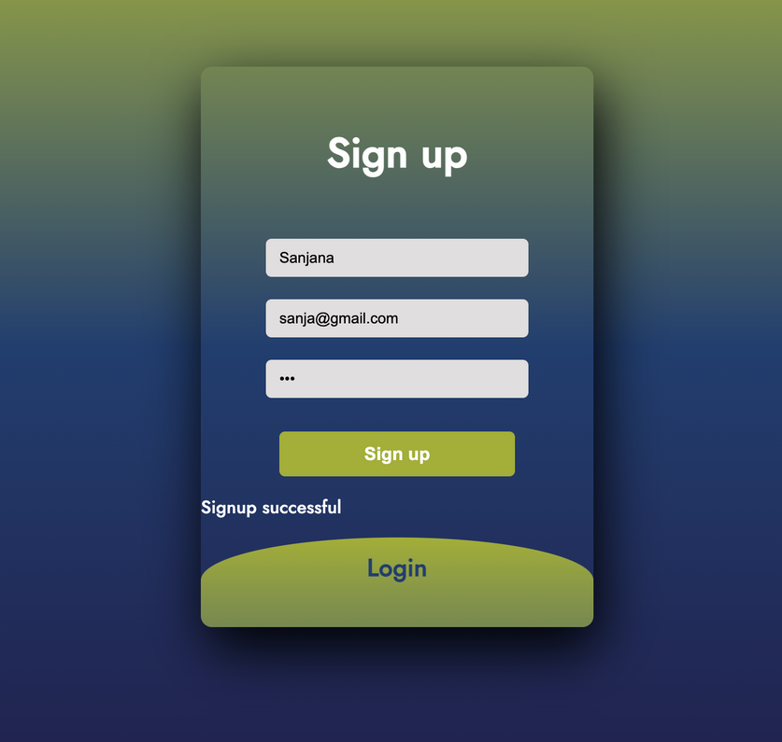
SIGN UP TEST CASES

Slide 13
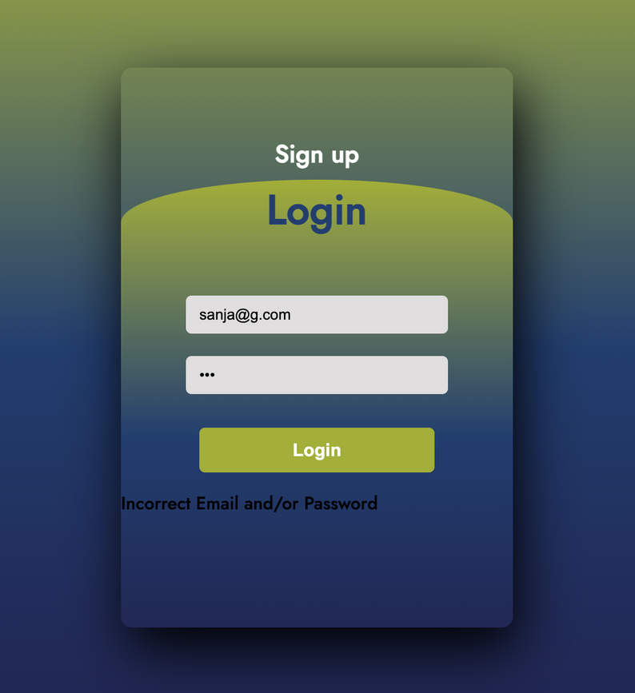
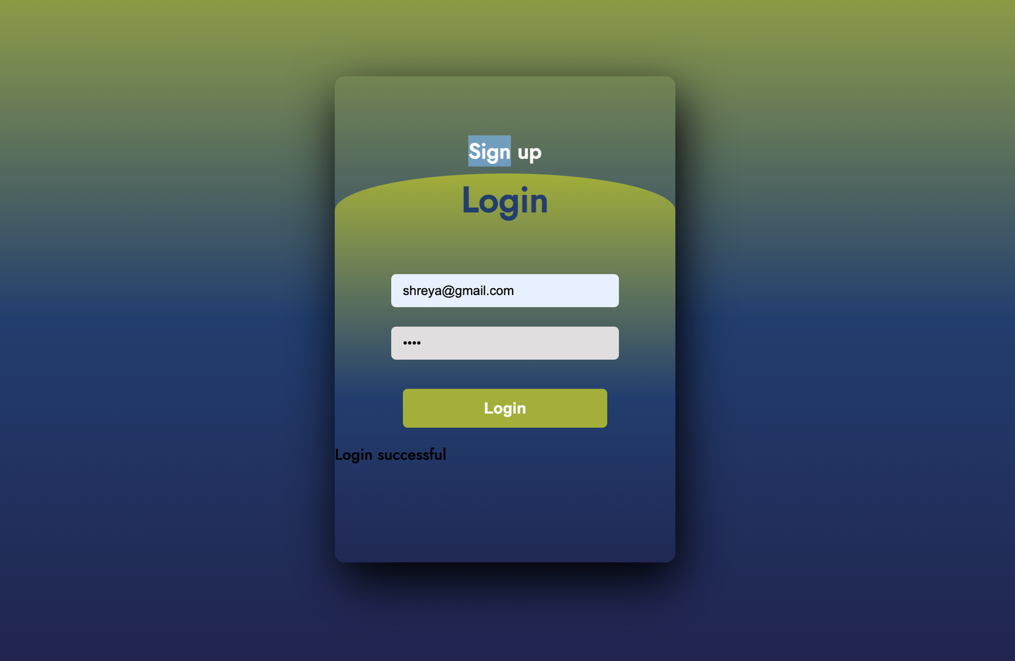
LOGIN TEST CASES

Slide 14
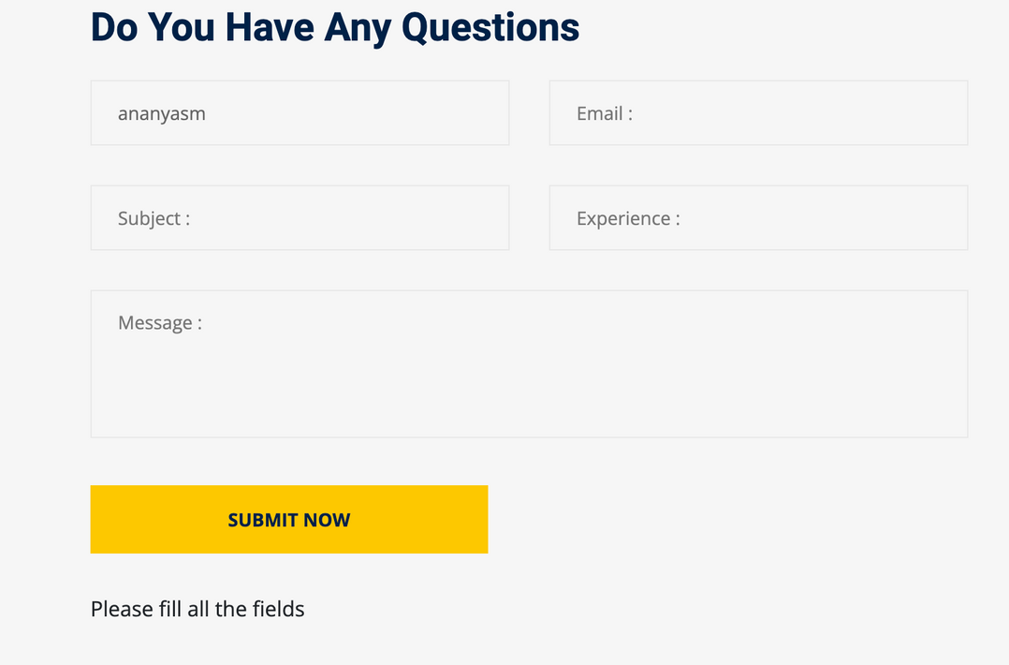
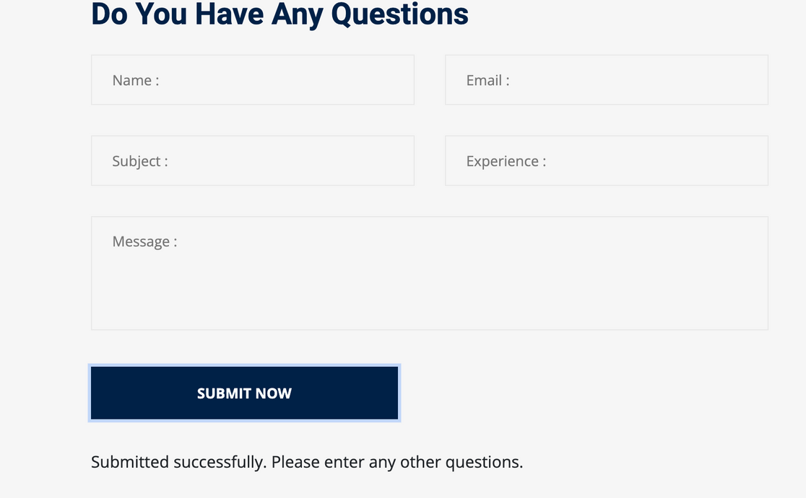
CONTACT FORM TEST CASE

Slide 15
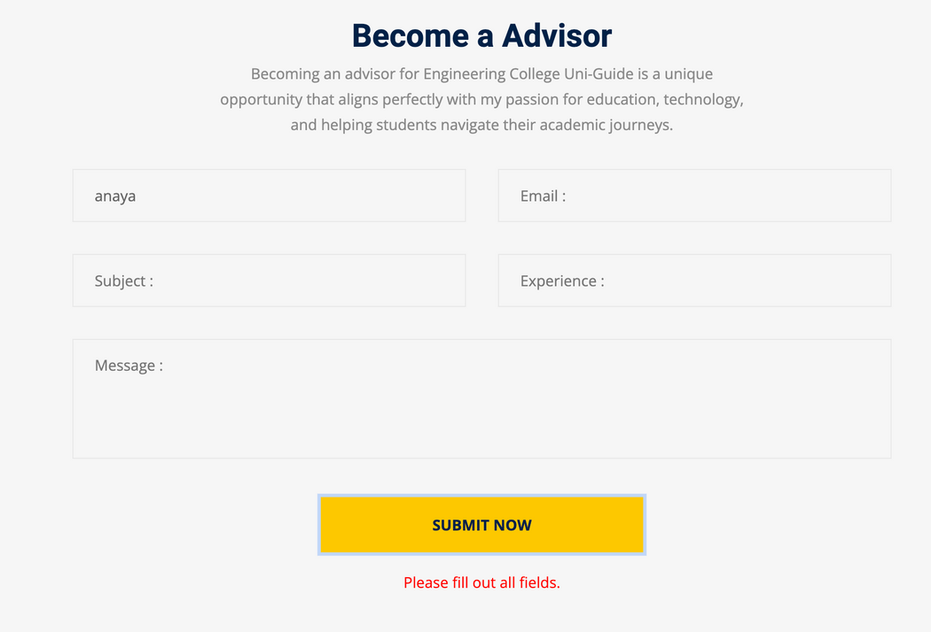
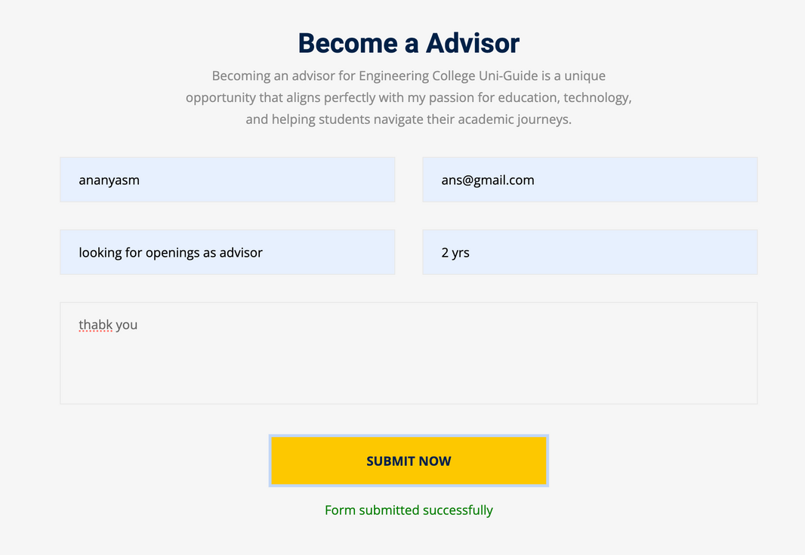
ADVISOR PAGE

Slide 16
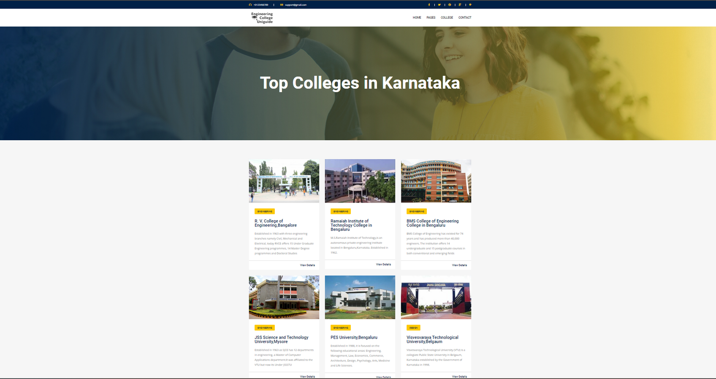
All Colleges View Page

Slide 17
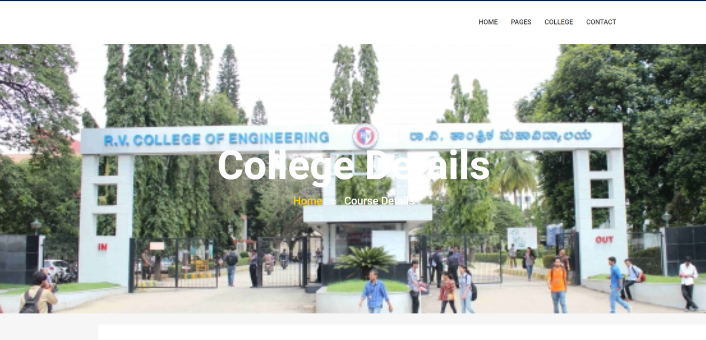
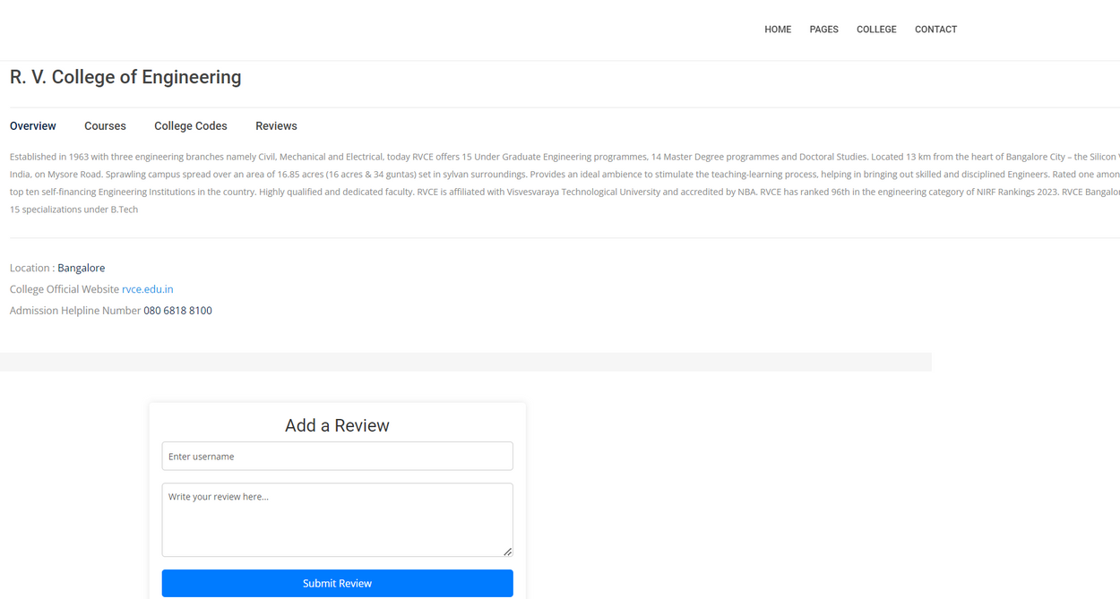
Single College Detailed View

Slide 18
Future Enhancements
Alumni Network Integration: Add a feature for connecting students with alumni for mentorship, career guidance, and networking, enhancing understanding of career pathways and industry insights.
College Database Expansion: Continuously update and expand the database to include new engineering colleges and updates on existing ones, ensuring comprehensive and current information for students.
Interactive Maps: Implement interactive maps to display the locations of engineering colleges in Karnataka, allowing users to explore colleges based on geographical proximity for an enhanced user experience.

Slide 19
CONCLUSION
In conclusion, Engineering College Uni-Guide serves two main objectives. It provides a user-friendly platform for KCET qualifiers in Karnataka, offering comprehensive information on engineering colleges to help students make informed decisions. Additionally, it offers personalized recommendations based on students' interests, locations, and branch preferences, simplifying the college selection process. By fulfilling these goals, Engineering College Uni-Guide aims to be a valuable resource for aspiring engineers, guiding them towards successful careers.

Slide 20

REFERENCES
https://www.researchgate.net/publication/370487450_Information_Retrieval_System_for_College_Search
https://www.collegedekho.com
https://www.academia.edu/52407274
https://cetonline.karnataka.gov.in/kea/
https://www.vocso.com/case-study/colleges18-colleges-search-website-development

Slide 21


Thank You

